Slide 1
Find a restaurant in Canada based on reviews on Yelp
Group Name： Data Pie
Date: 7 Jan 2019

Slide 2
Outline
Project introduction
Process and techniques
Application sample

Slide 3
Project Introduction
What is our project about?
- Evaluate the rating scheme of Yelp with user reviews for restaurants in Canada in 2017 and 2018
- Recommend restaurants to users based on current user reviews
Main steps of our project
- Data Preprocessing and Exploration
- Sentiment Analysis
- Rating and Recommend system building and evaluation
- Explanation

Slide 4
Process and techniques
Data preprocessing
- Data collection : Three Yelp datasets (188k restaurants, 152k user info and 5997k reviews information)
- Data cleaning : Remove irrelevant words from reviews, keep data of cities in Canada which have
more than 500 restaurants (Year: 2017，2018)
Data Exploration
- Filter Top 50 restaurants with most reviews
- Explore the relationship between ratings of these 50 restaurants and the amount of reviews
(Method: Pearson product-moment correlation coefficient)
- Extract key words of restaurants to find Top 30 popular types of restaurants in Canada

Slide 5
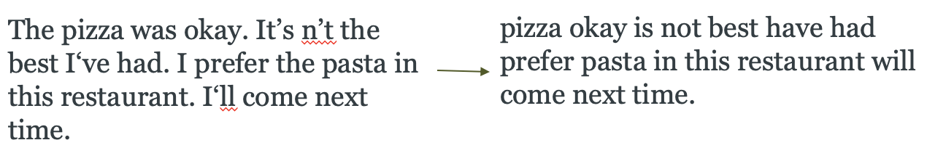
Process and techniques

Slide 6
Process and techniques
Sentiment Analysis
- ﻿ Feature engineering: use Tf-idf to vectorize train dataset and transform test set
- ﻿ Test vocabulary with a random review
- Build model to predict rate based on reviews
Compare the performance of three classifiers: Naive Bayes, Logistic Regression and Random Forest
- Verify classifiers by cross validation
- Use grid search to find the best predictable classifier
- Reduce dimensions by PCA

Slide 7
Process and techniques
Clustering and building rating system
- ﻿ Task description:
Existing rating system is not completely reasonable (new rating method is needed)
Replace it with new clustering methods (K-Means)
Compare to what extent the reviews and new clusters match with each other
- Cluster process:
1. convert reviews to 2 clusters
2. convert reviews to 3 clusters
- Conclusion: 3 clusters system has a better performance in presenting relationship between reviews and clusters

Slide 8
Process and techniques
Recommend system building
- ﻿Recommend restaurants to existing users
- ﻿Approach: Item - Item Collaborative Filter, Matrix Factorization-NMF, Matrix Factorization-SVD
- Compare the performance
1. Select one user randomly
2. Provide them with top ten recommendations
3. Compare the common categories from user rated restaurants and recommended restaurants
- Conclusion
SVD recommendation system has the best performance with the fastest computational speed

Slide 9
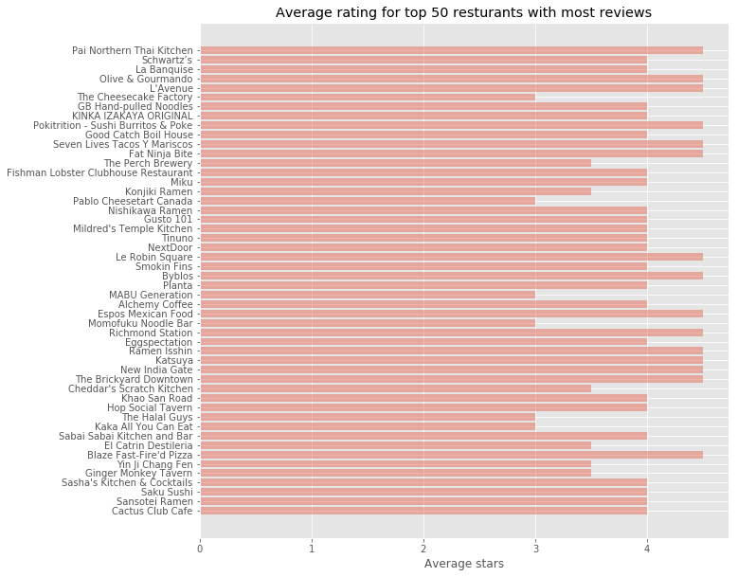
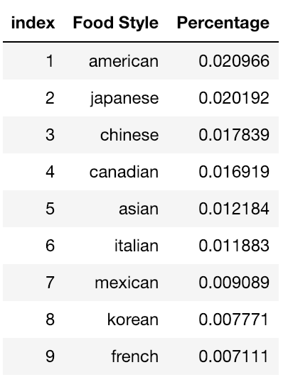
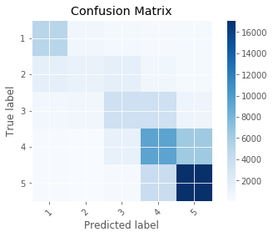
Process and techniques
Some visualizations and conclusions
- ﻿The correlation coefficient between the number of reviews and average rating is 0.146933, which means the relationship between the number of reviews and average ratings is weak.
- ﻿Top 9 food styles in Canada in 2017 and 2018 are shown in the table right.
- ﻿It is hard to separate 4 stars restaurants from 5 stars restaurants, the same situation occurs in 3-4 stars restaurant(The confusion matrix is on the right).
- ﻿3 ranking system is better when recommending restaurants.
- ﻿An example of the recommendation result(based on userID):

Slide 10
Thank you

